Slide 1
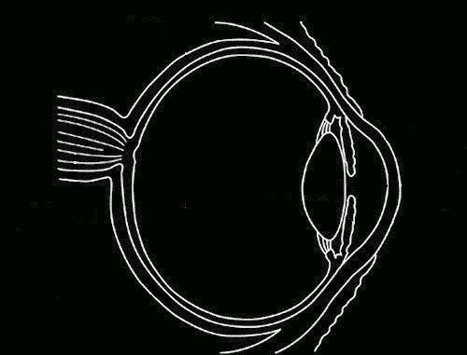
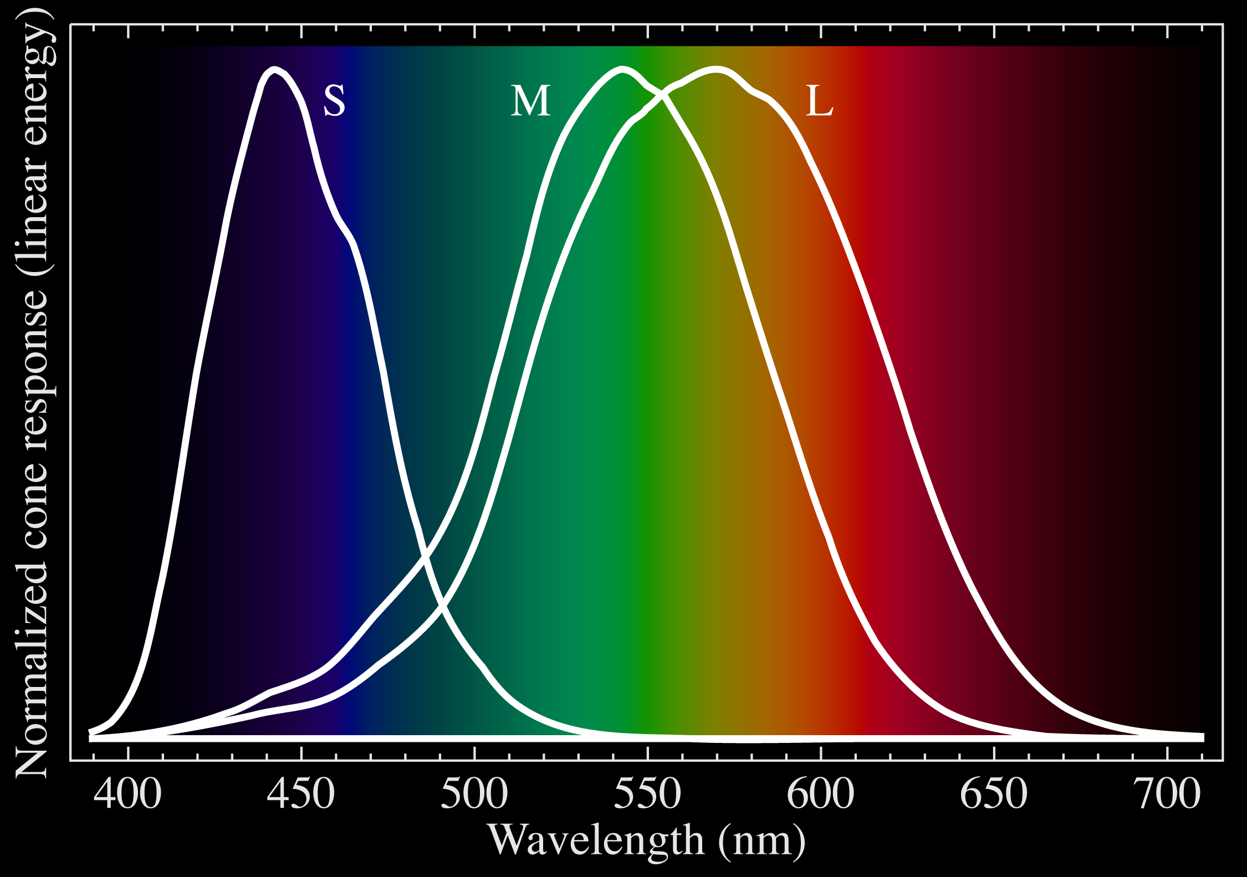
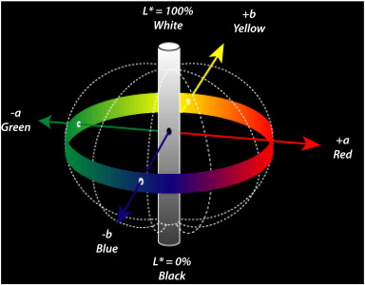
Using Color in Your Diagrams and Presentations
Kenneth Moreland
Sandia National Laboratories

Slide 2
What is color?
Is black a color?

Slide 3
Gamma-rays
0.01 nm
0.1 nm
X-rays
1 nm
10 nm
400 nm
Ultraviolet
100 nm
Visible
1 μm
Infra-red
10 μm
700 nm
100 μm
1 mm
Microwaves
1 cm
10 cm
1 m
Radio, TV
10 m
100 m
Long-waves
1 km

Slide 5
Corollary
Color is perceived through the response of three cone receptor types
Therefore, any color can be represented by the intensity of three given wavelengths based on their relative responses
Known as the trichromatic theory

Slide 6
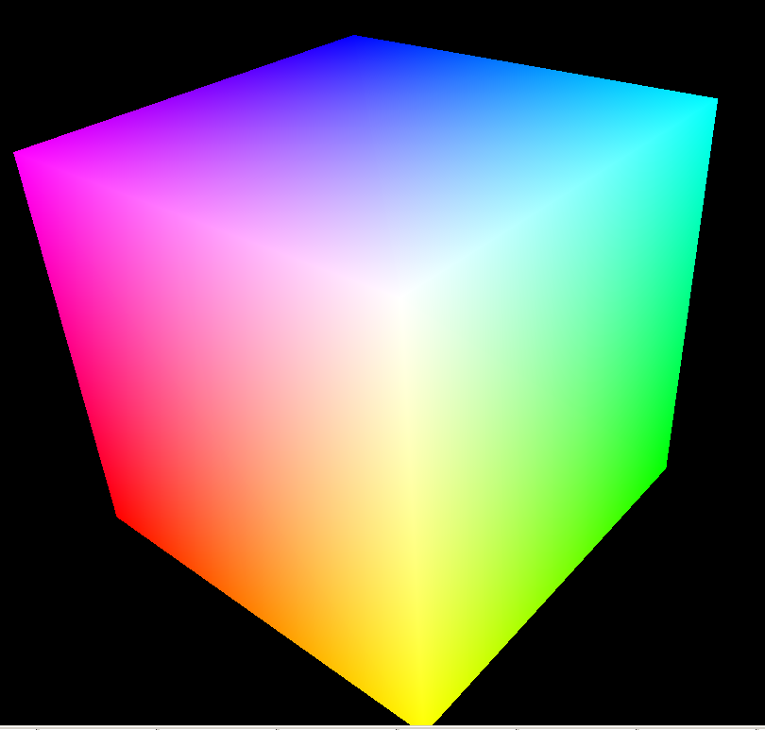
Blue
Green
Red
Notes:
Color space diagrams
Additive vs. subtractive color space

Slide 7
Caveat
Some colors (particularly pure frequencies) have a response that requires a negative response by R, G, or B
Not physically possible

Slide 8
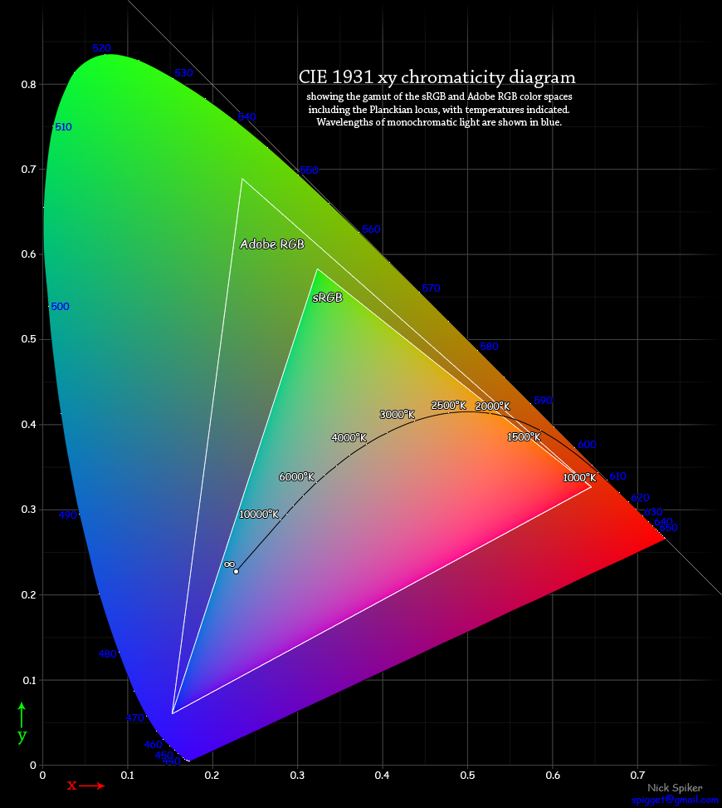

Slide 9
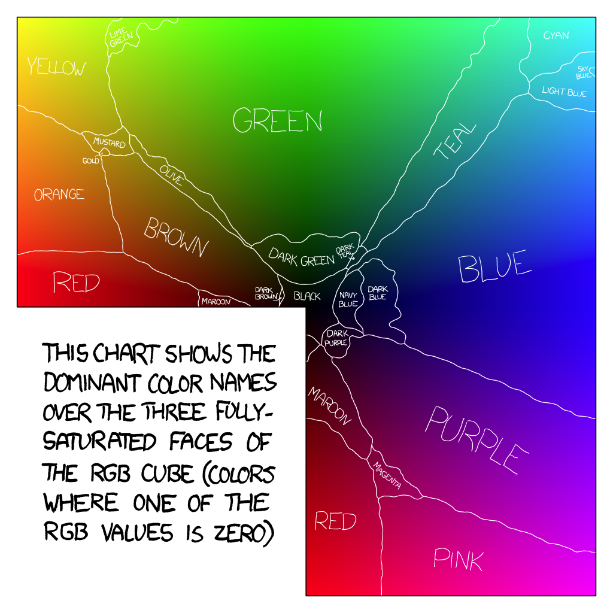
Notes:
Randall Munroe, former NASA roboticist and author of XKCD.

Slide 10
Notes:
Munsell color system
Albert Munsell, 1905
A perceptual color space
Designed such that the Euclidean distance between two colors is proportional to the perceptual difference.

Slide 11
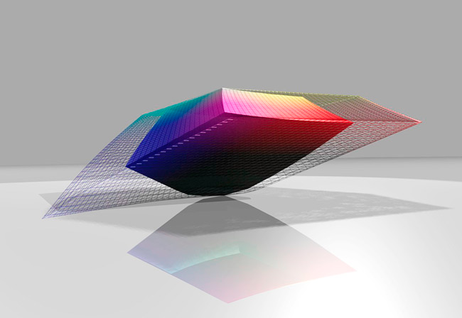
Notes:
Many perceptual spaces designed since Munsell using further perceptual studies and better understanding of the physics and physiology
Pretty similar to Munsell’s original design
This the CIE Lab space designed in 1976 is often used today
Note that the cube color gamuts we saw earlier are now squashed and deformed in weird ways
If you are representing numbers as colors, it is better to work in a perceptual color space so that the “difference” in colors is representative of the difference of the numbers

Slide 12
Notes:
CIE Lab is based on color-opponent theory, which states that we interpret colors using pairs of antagonistic colors.
There are (unsurprisingly) three pairs: black/white, blue/yellow, and red/green
These colors are easy to contrast because we never blend these colors; there is no reddish-green or bluish-yellow.

Slide 13
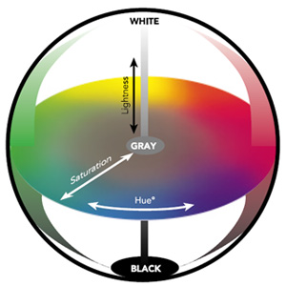
Notes:
Another feature of CIELAB: If we consider the polar coordinates of the space, it represents the perceptually significant features of lightness (how bright it is), hue (the dominant perceived wavelength or rainbow color), and saturation (how dominant the hue is)
Full saturation means the color represents a single wavelength (rainbow color)
No saturation means the color is black, white, or some shade of gray and hue has no meaning
Thus, this black/white axis represents a singularity in our visual system
Returning to the question, “Is black a color?”
Answer: yes. Black is a fully represented color in any valid color space
But it is special in a couple of ways
It has no hue, which the word color is often used to describe. Often when someone says black, white, or gray is not a color, they mean it has no hue or dominant wavelength
Black also happens to represent no activation in the visual system (sort of). But that does not mean this lack of activation is perceived as anything other than a point in the color space

Slide 14
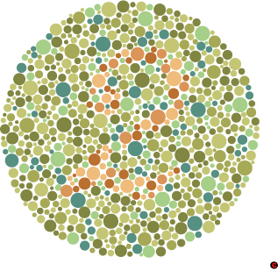
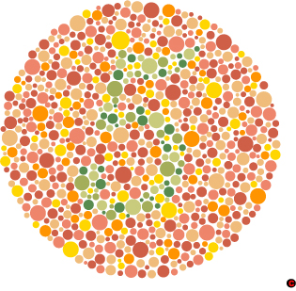
Notes:
You should also be aware that some people are color deficient
There are several types of color deficiencies, but most times it knocks out the ability to differentiate between the red and green hues.
This is the Ishihara test

Slide 18
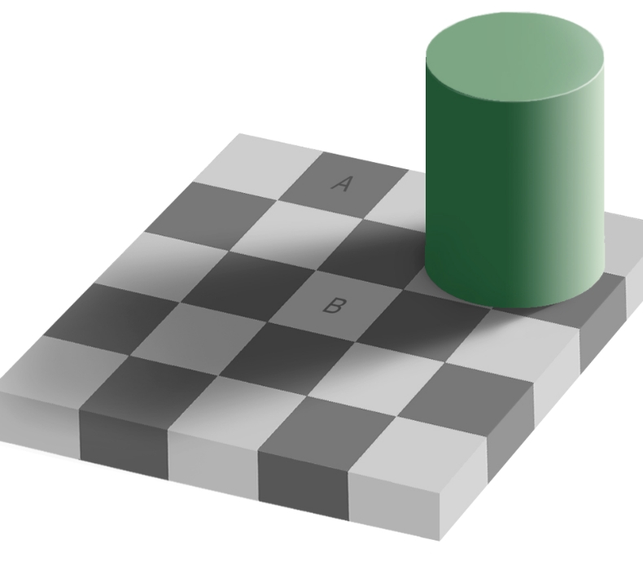

Slide 20
Notes:
Summary, you need some variance in luminance to catch high-frequency changes, but you should add some hue or saturation change as well to adjust for bias in the visual system.

Slide 21
Isoluminant colors (colors with the same brightness) are sometimes recommended because they have several advantages. They avoid dominance of one color over another and can be applied to 3D objects without interfering with shading cues.
However, in addition to generally being ugly, isoluminant colors are harder to distinguish from one another, particularly at close range. That is, their high frequency response is poor. That is why these words are hard to read. They might be vibrating your visual field and/or producing a headache.

Slide 23
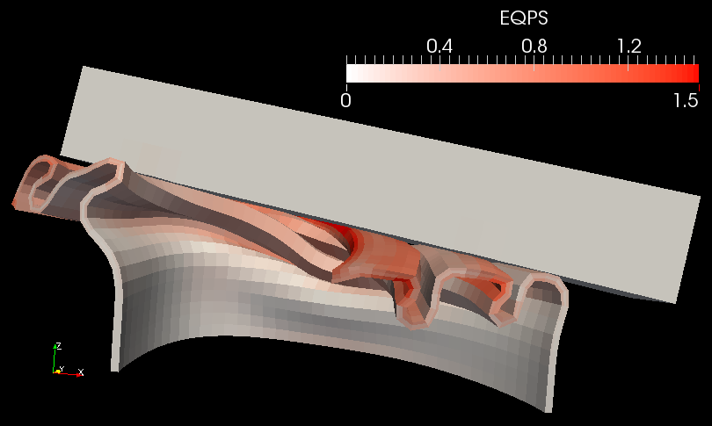
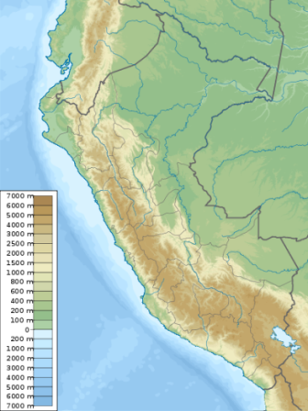
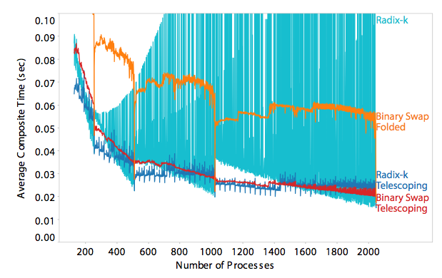
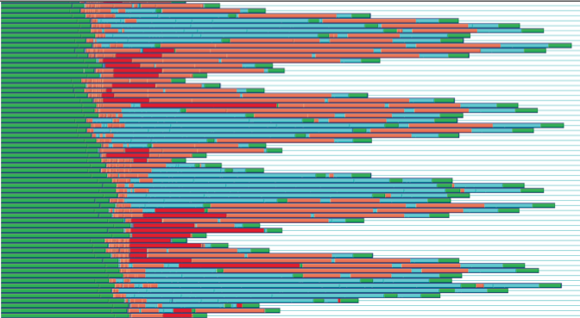
Number by Colors
Sequential A continuous spectrum with low and high ends
Temperature, Pressure, Mass, Stress, Strain, Volume Fraction, Rainfall
Diverging A continuous spectrum with a significant middle point
Temperature around freezing, Elevation around sea level
Qualitative A discrete set of classes with no particular order
Series in a plot
Event types

Slide 24
Example Sequential Color Maps

Slide 25
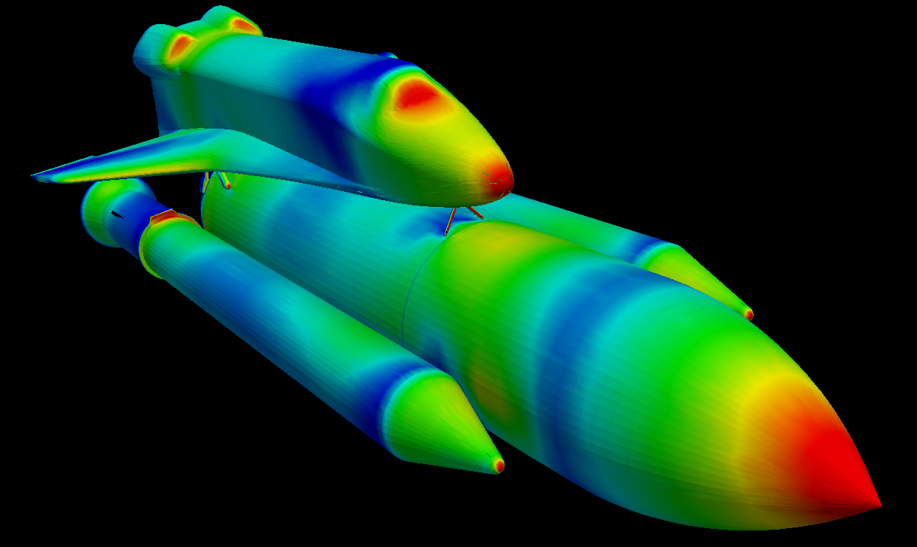
Rainbow
Pros:
Pretty
Good dynamic range
Cons:
Garish
Bad for color deficiencies
No implicit order
Not perceptually even

Slide 26
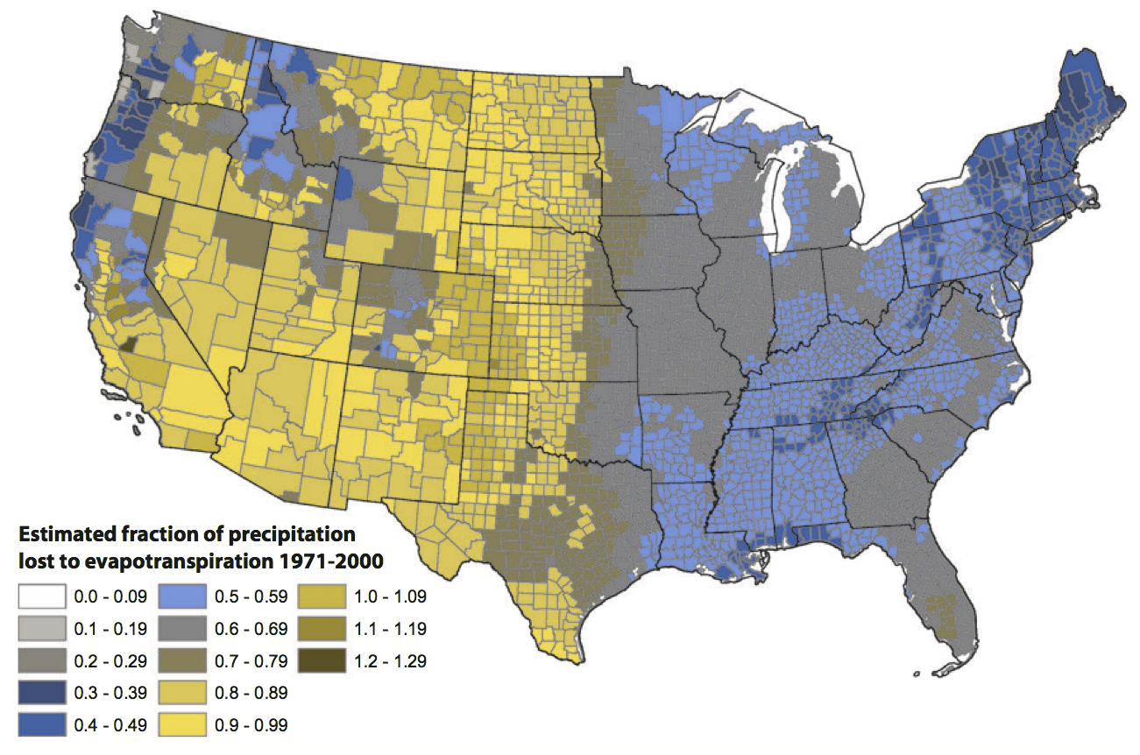
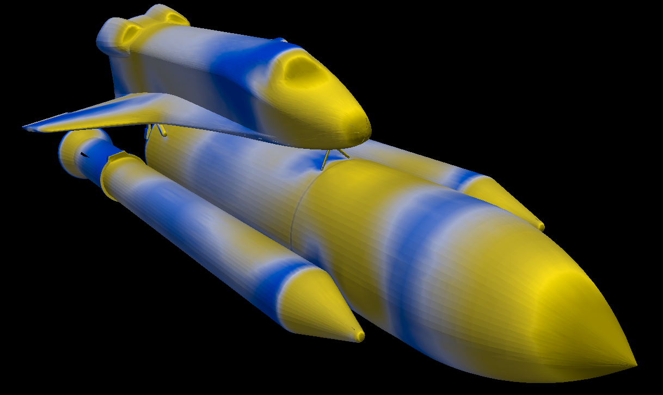
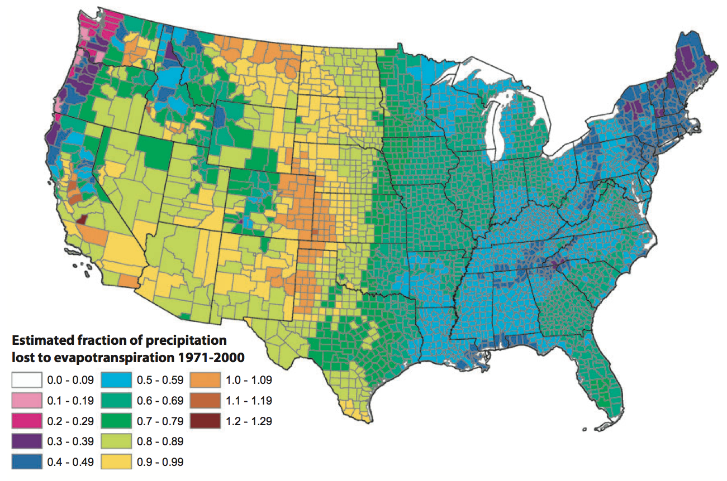
Rainbow: Color Deficiencies
Notes:
Simulating deuteranope color deficiency.

Slide 27
Rainbow: Implicit Ordering
✔
✗

Slide 28
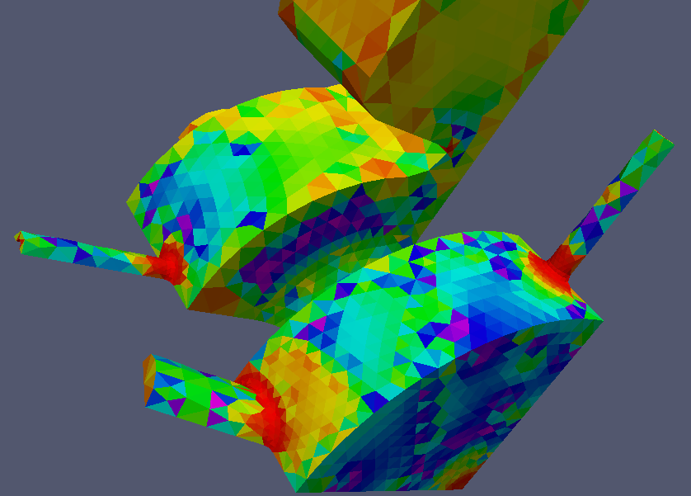
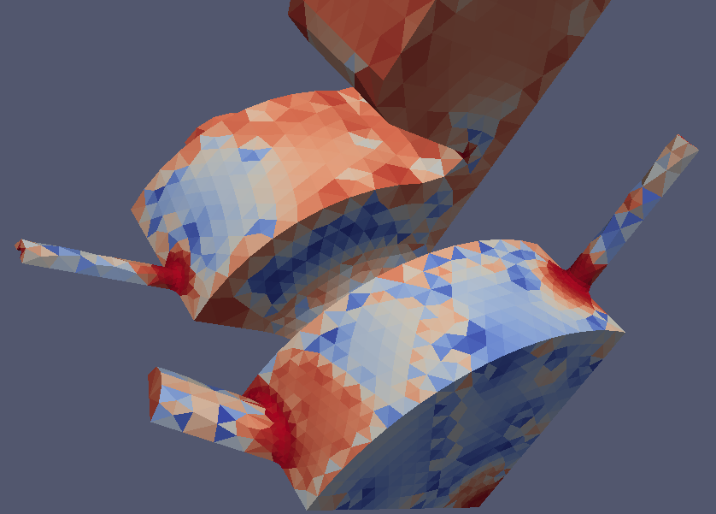
Rainbow: Implicit Ordering

Slide 29
Rainbow: Perceptually Uneven
Blue
Cyan
Green
Yellow
Orange
Red

Slide 31
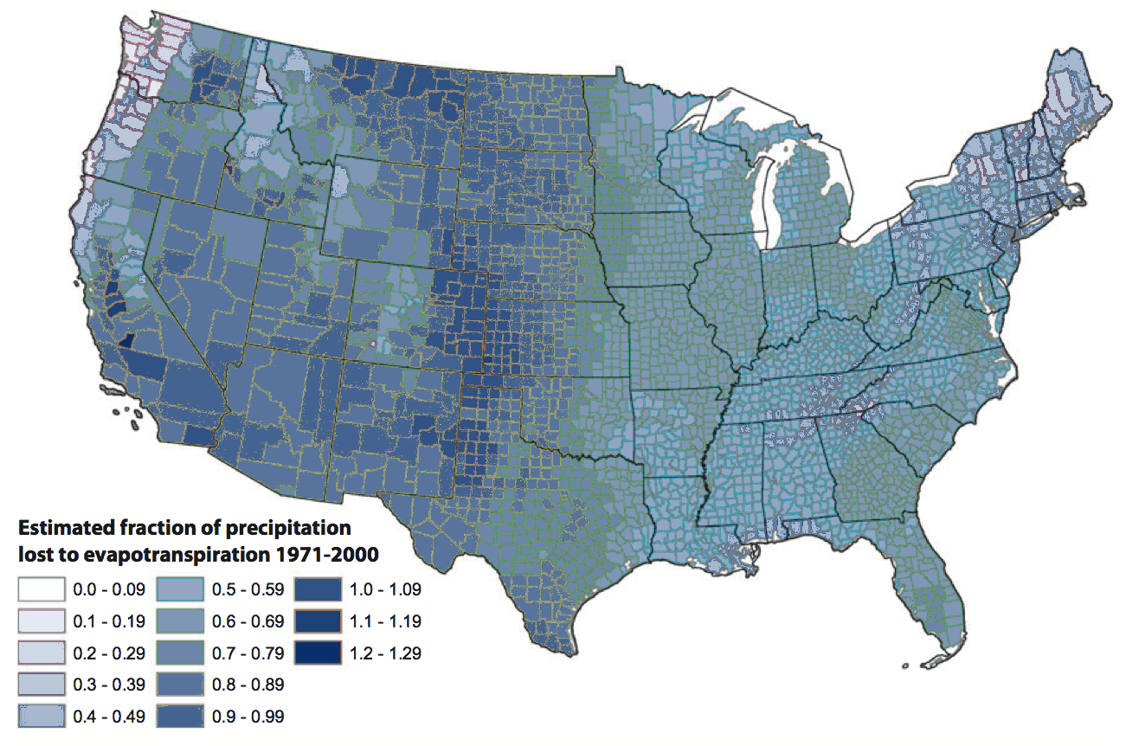

Slide 32
Grayscale
Pros:
Good dynamic range
Excellent contrast
Cons:
Dark colors disrupt 3D shading
Susceptible to bias from surroundings
Dull

Slide 33
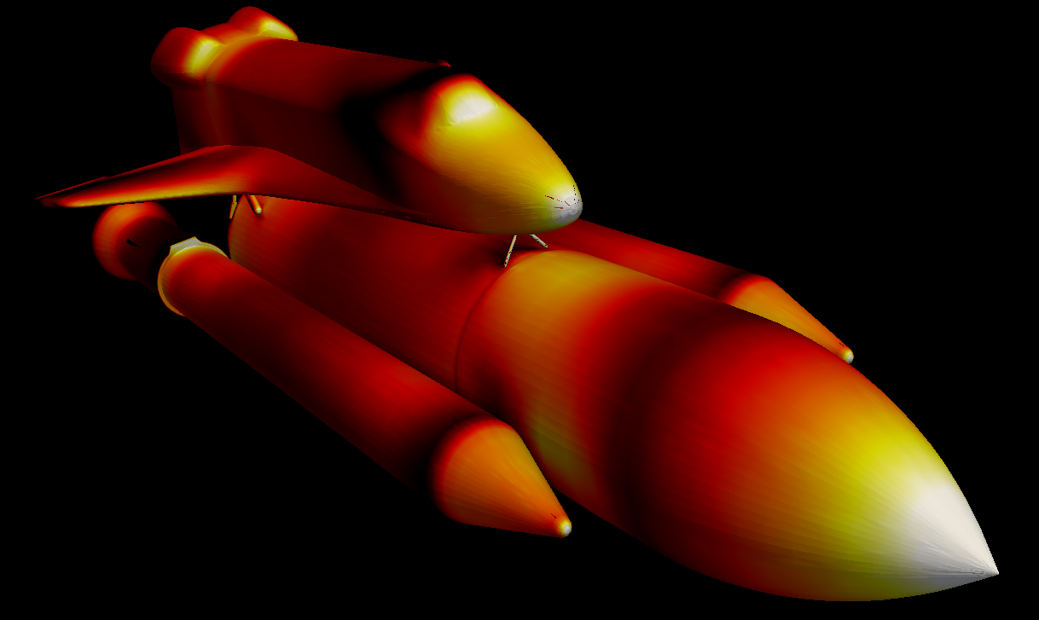
Black Body Radiation
Pros:
Good dynamic range
Excellent contrast
Cons:
Dark colors disrupt 3D shading

Slide 34
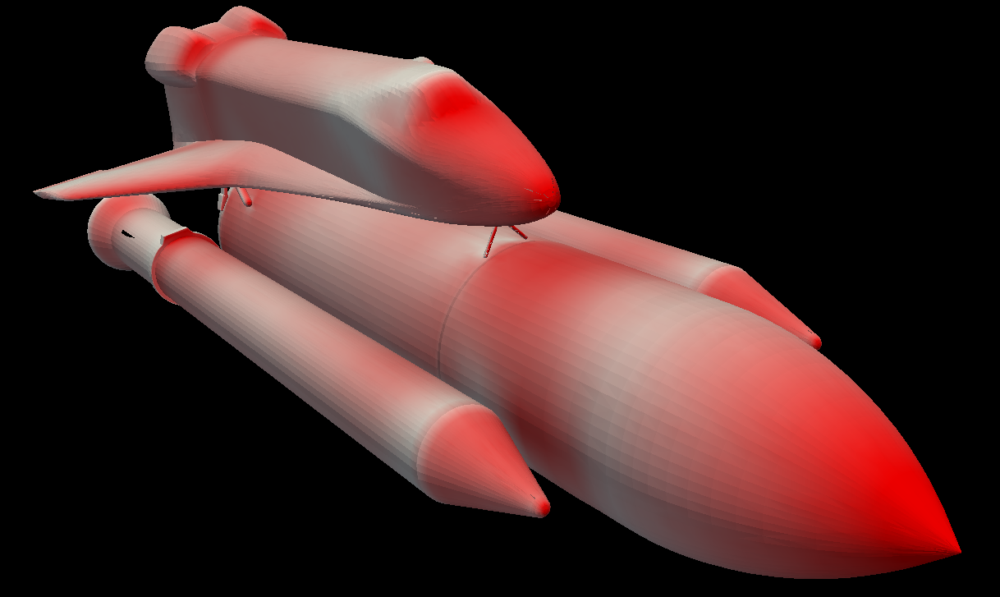
Saturation Scale
Pros:
Clear ordering (polarity may depend on context)
Easy to customize (choose any color)
Can be layered by other colors
Cons:
Moderate dynamic range

Slide 35
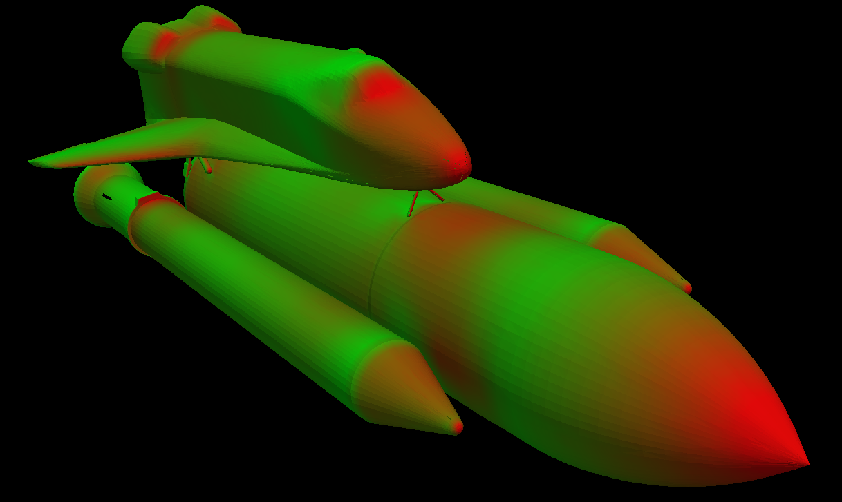
Green/Red
Pros:
Decent dynamic range
On color-opponent perceptual axis
Isoluminant(ish)
Cons:
Isoluminant(ish)
Very susceptible to color deficiencies
Ugly

Slide 36
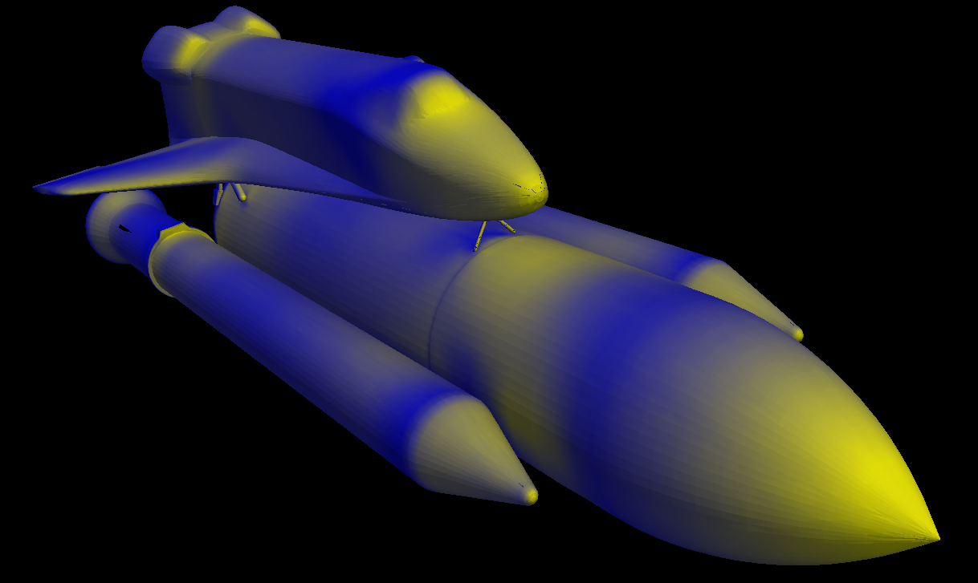
Blue/Yellow
Pros:
Good dynamic range
On color-opponent perceptual axis
Also has high luminance variety
Cons:
Hard to layer other colors

Slide 37
Diverging Color Maps
Pick two colors and a neutral center

Slide 38
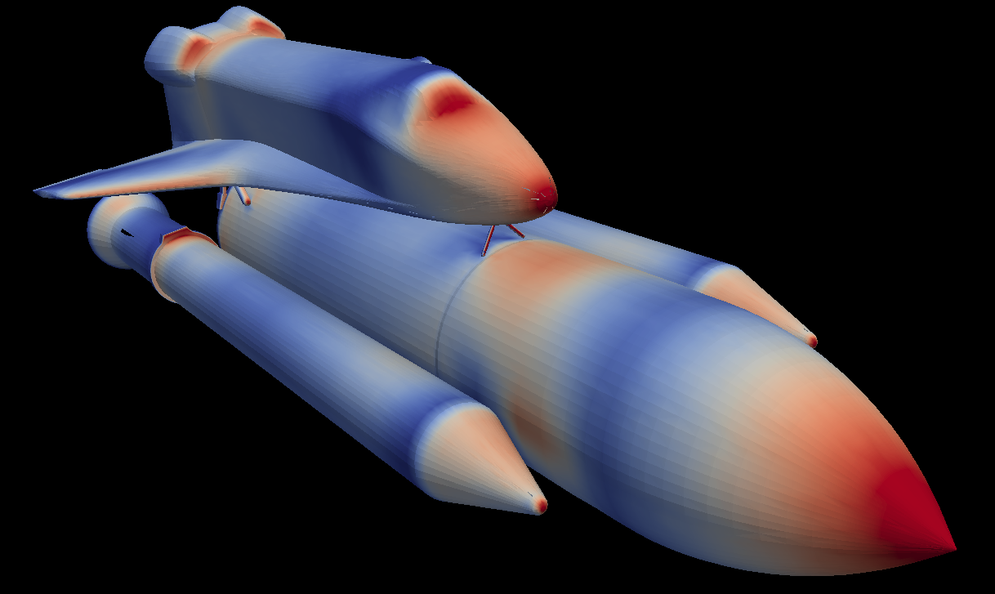
Using Diverging for Sequential

Slide 39
Choosing Qualitative Colors
Consider colors named in different languages across cultures
Indicative of perceptually noticeable colors without cultural bias
Berlin and Kay (1969)
>100 languages
Ware (2004)
In order of likelihood of incidence
White
Black
Red
Green
Yellow
Blue
Brown
Pink
Purple
Orange
Grey

Slide 40
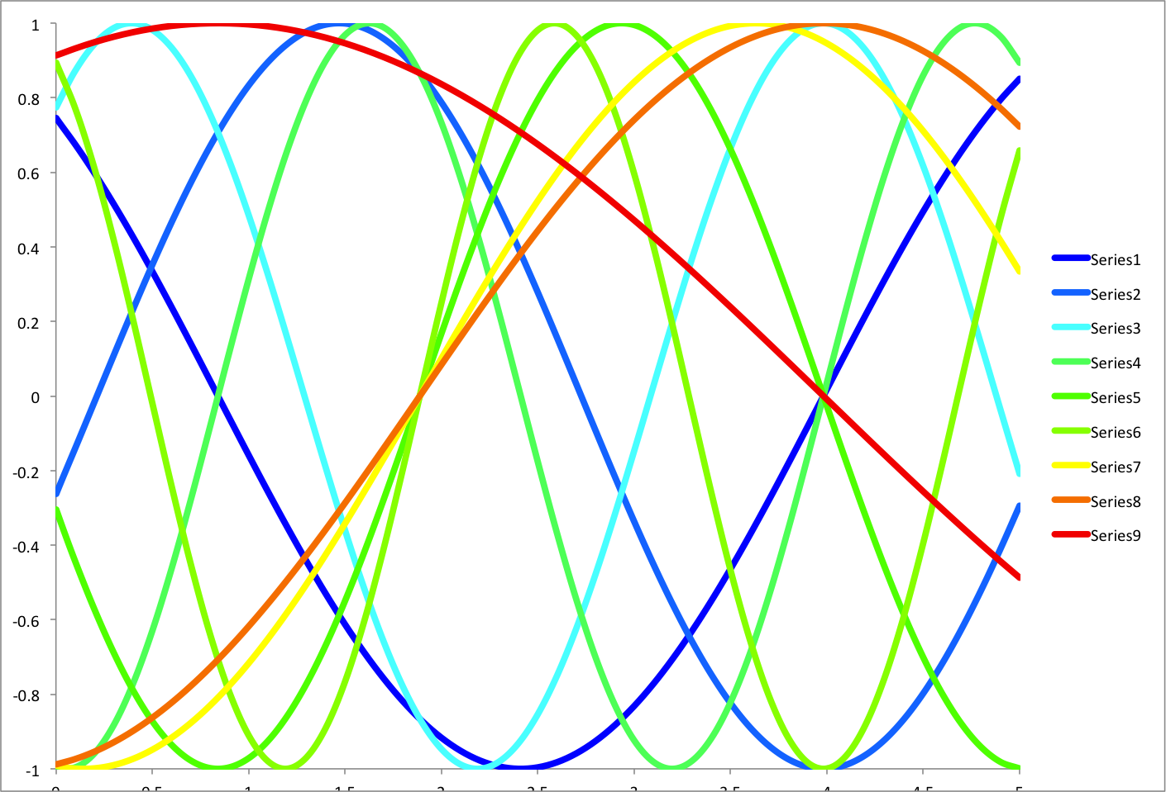

Slide 42
Qualitative Color Guidelines
Choose colors easy to distinguish (previous colors a good start)
Use bold, saturated colors for “thin” objects
Plots, points, lines
Use muted colors for thick objects
Maps, block diagrams, areas
Avoid too many categories
Hard to distinguish past 12 colors (including background)
Generally hard to consider more than 7 tokens anyway
Consider grouping categories (different shades of similar color)

Slide 43
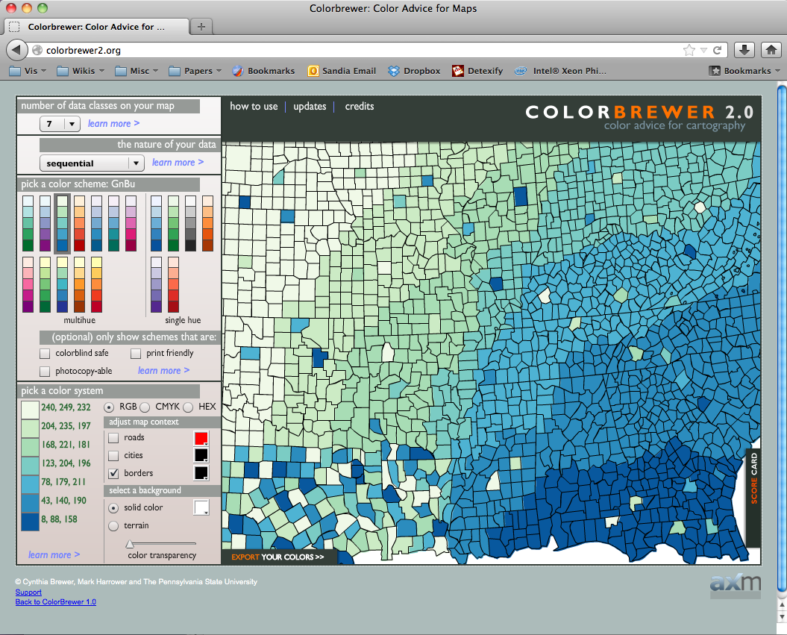
http://colorbrewer.org

